Slide 1
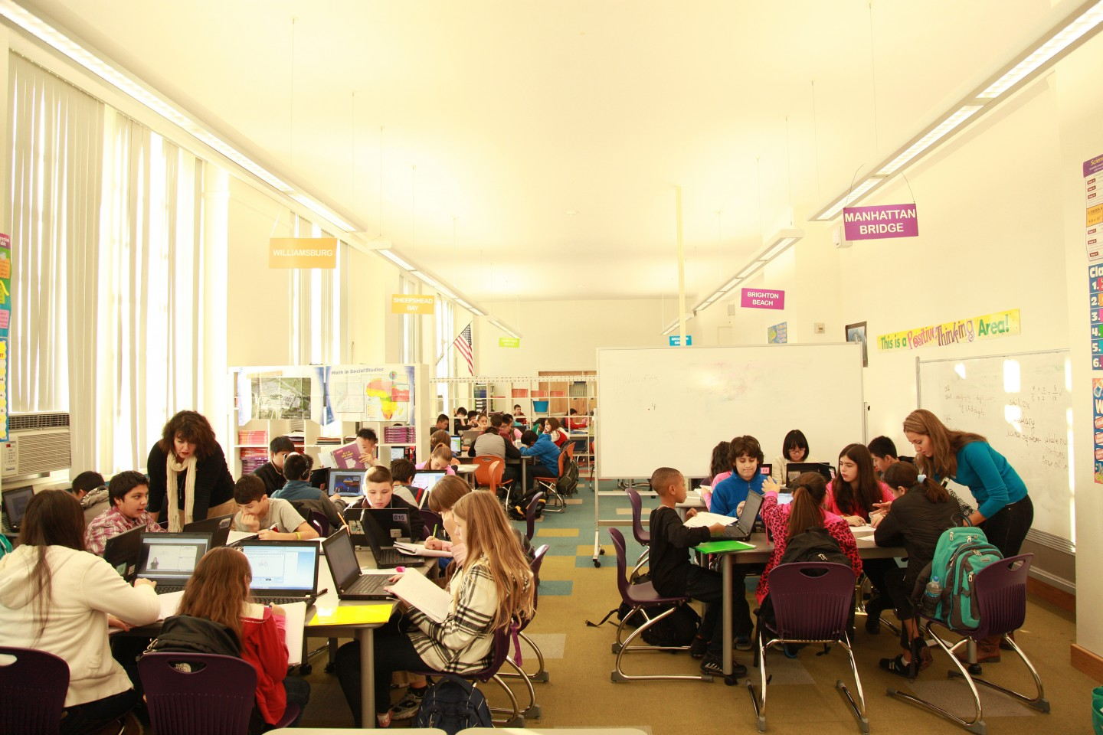
The Fifth Discipline Applied to Blended
Stephanie Peborde Burke
New Jersey City University
New Classrooms. (n.d.). A blended learning classroom at David Boody Jr. High School in New York City. [photograph].
Retrieved from https://ww2.kqed.org/mindshift/2015/01/12/some-benefits-and-drawbacks-of-blended-learning/

Slide 2
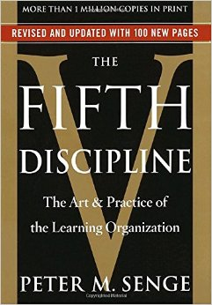
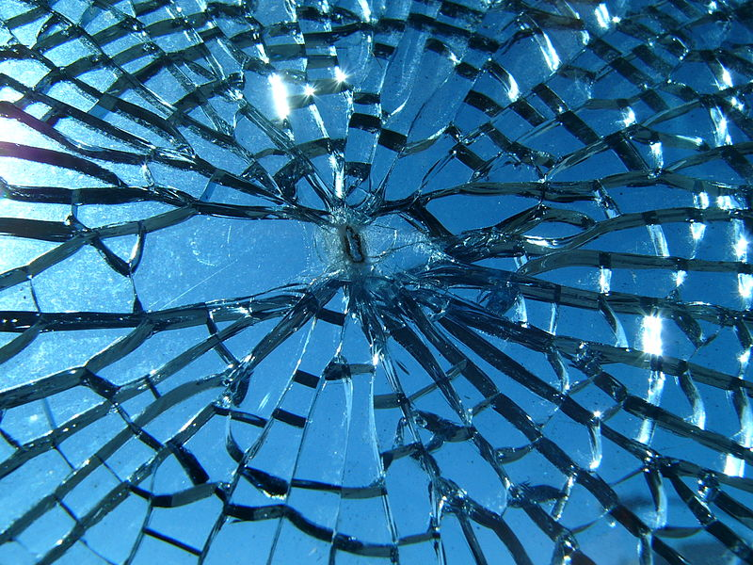
Poskanzer, J. (2008). Broken Glass. [photograph]. Retrieved from https://commons.wikimedia.org/wiki/File:Broken_glass.jpg Amazon.com. (n.d.). [photograph]. Retrieved from https://www.amazon.com/Fifth-Discipline-Practice-Learning-Organization/dp/0385517254

Slide 3
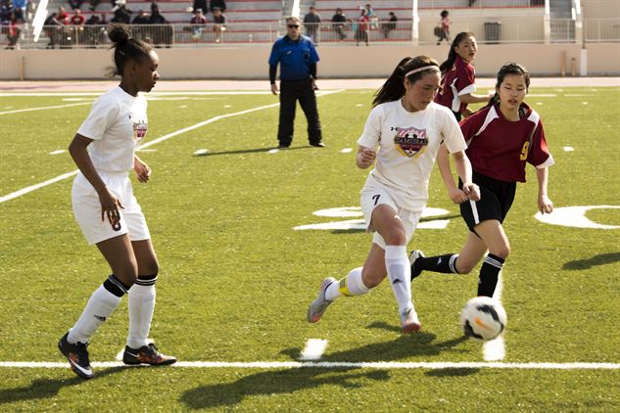
Campbell, S. (2017). Reaching Goals. [photograph]. Retrieved from http://www.mcasiwakuni.marines.mil/News/News-Stories/News-Article-Display/Article/1110644/reaching-goals/
Geralt. (2016). [digital image]. Retrieved from https://pixabay.com/en/group-team-feedback-confirming-1825510/

Slide 4
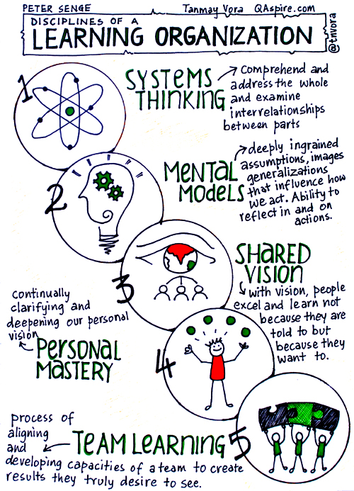
Vora, T. (2015). Disciplines of a Learning Organization. [digital image]. Retrieved from http://qaspire.com/2015/12/07/disciplines-of-a-learning-organization-peter-senge/

Slide 5
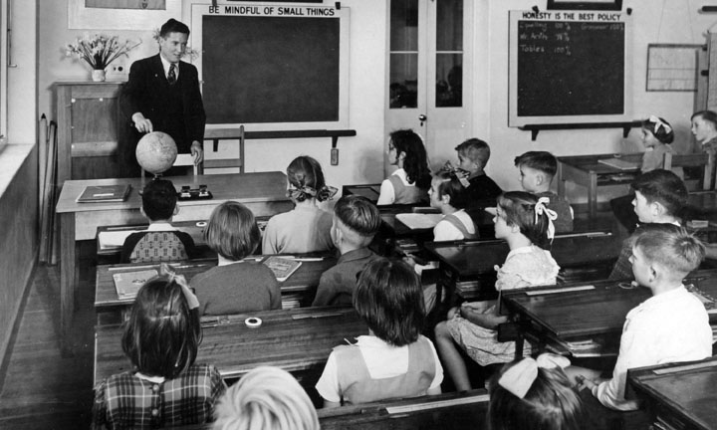
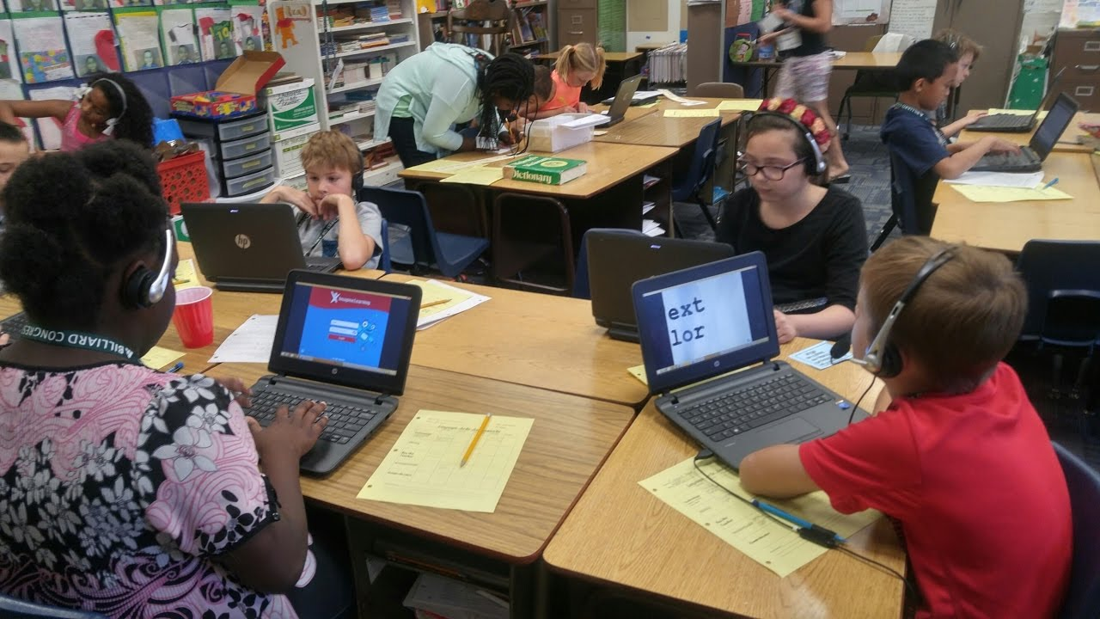
Agriculture and Stock Department, Publicity Branch. (1951). Kelvin Grove State School, Teacher and Class. [photograph]. Retrieved from https://commons.wikimedia.org/wiki/File:Queensland_State_Archives_1640_Kelvin_Grove_State_School_Teacher_and_Class_April_1951.png
Peoria Unified C&I. (2017). Blended Learning with Station Rotations Intermediate Grades 3-5. [photograph]. Retrieved from https://i.ytimg.com/vi/9zCoYtvxut8/maxresdefault.jpg

Slide 6
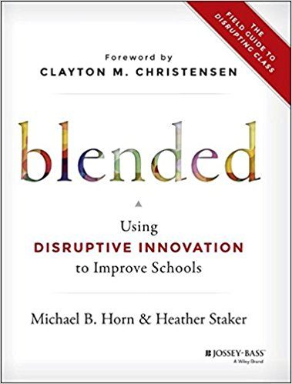
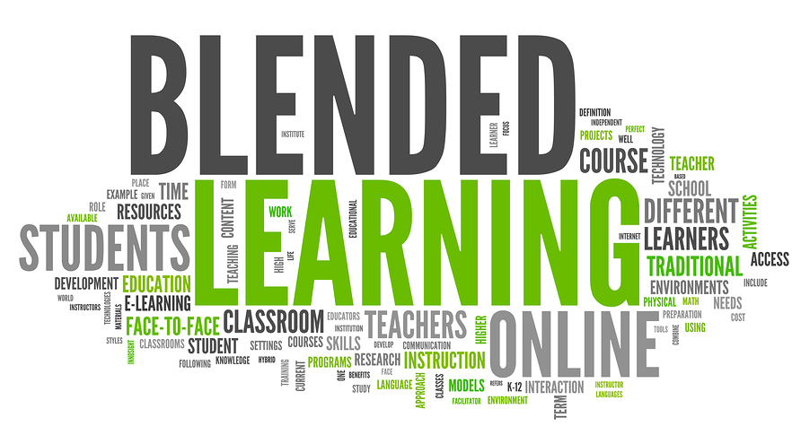
Amazon.com. (n.d.). [photograph]. Retrieved from https://www.amazon.com/Blended-Disruptive-Innovation-Improve-Schools/dp/1118955153
Cutler, D. (2014). Newblended.jpg. [digital image]. Retrieved from http://www.spinedu.com/redefining-blended-learning/

Slide 7
Mastroyiannis, M. (2015). Exponential Disruptive Innovation. [digital image]. Retrieved from https://www.slideshare.net/MikeMastroyiannis/exponential-disruptive-innovation-what-is-this

Slide 8
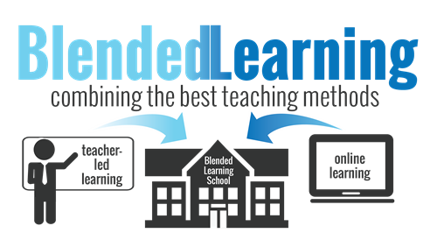
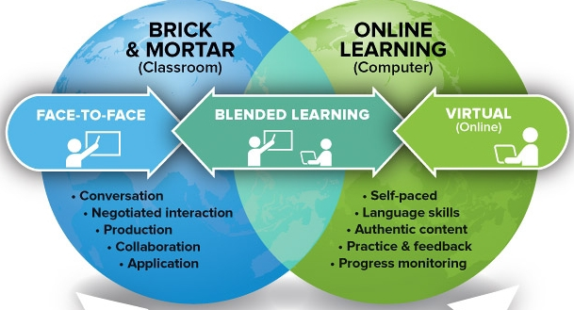
Whang, E. (n.d.). [digital image]. Retrieved from https://achieve.lausd.net/Page/11473
The Tesla Academy. (n.d.). [digital image]. Retrieved from http://www.theteslaacademy.com/whatisblended/

Slide 9
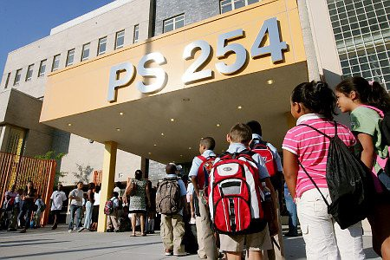
NYU Local. (2016). [photograph]. Retrieved from https://nyulocal.com/nyc-public-schools-are-still-segregated-f75e7720bff3 Ed.gov. (2012). Rural Education. [photograph]. Retrieved from https://blog.ed.gov/2012/02/how-are-you-increasing-opportunities-in-rural-schools/

Slide 10
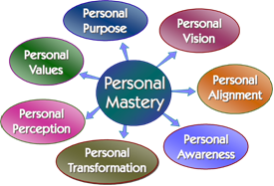
Cropper, B. (2014). [digital image]. Retrieved from http://www.thechangeforum.com/Personal_Mastery.htm

Slide 11
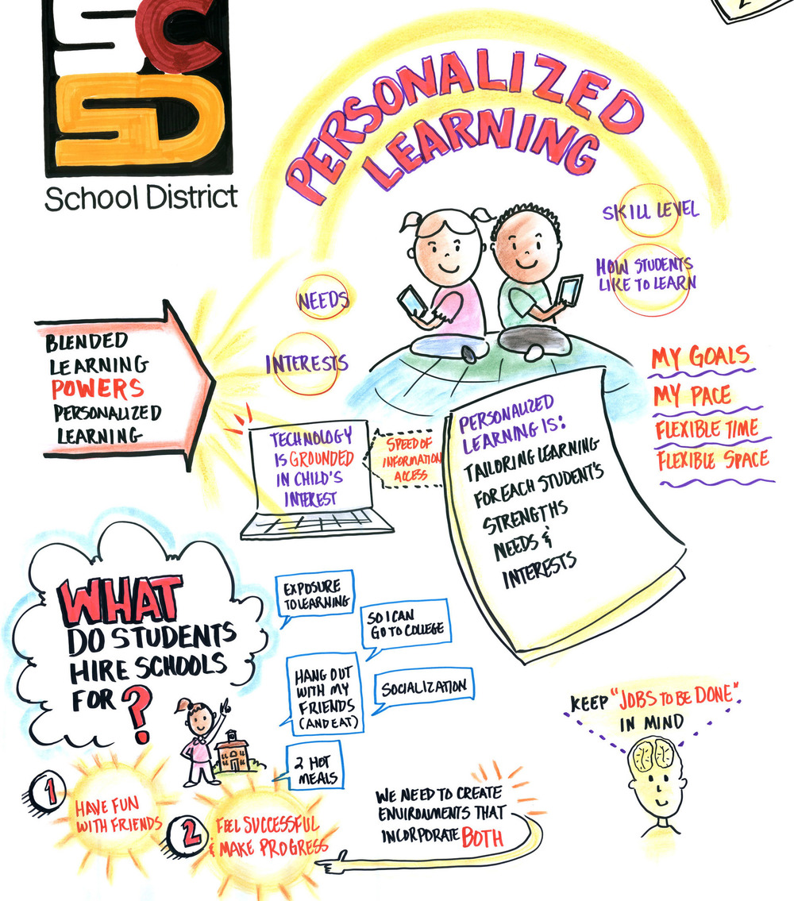
@sohphialinag. (2015). Personalized Learning. [digital image]. Retrieved from
http://www.graphicrecordingstudio.com/blog/2015/7/13/personalized-learning

Slide 12
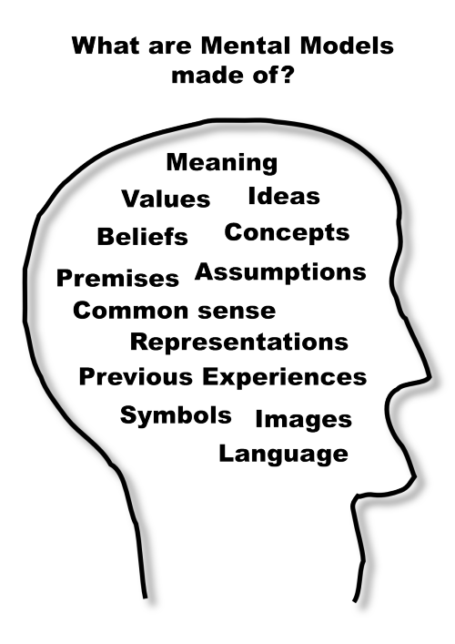
Mental Models Game. (2015). [digital image]. Retrieved from http://blog.mentalmodelsgame.com/page/2

Slide 13
Waters Foundation. (2013). [digital image]. Retrieved from http://www.watersfoundation.org/webed/habits/mentalmodels.htm

Slide 14
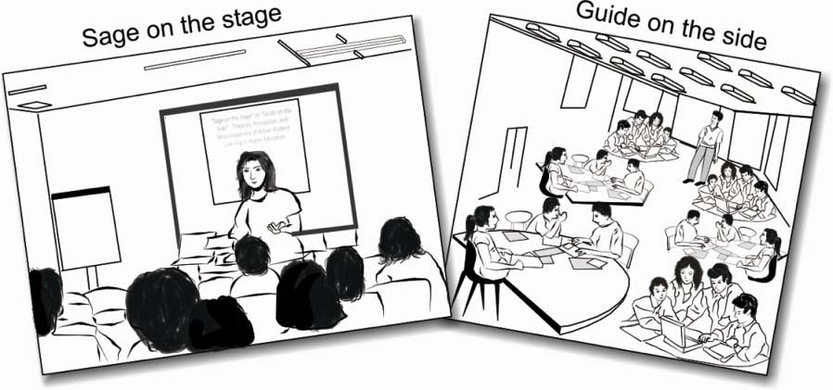
Engineering Institute of Technology. (n.d.). [digital image]. Retrieved from http://www.eit.edu.au/creating-useful-education-and-training

Slide 15
Grimsley, S. (n.d.). [digital image]. Retrieved from http://study.com/cimages/videopreview/9bd9eqwbmb.jpg

Slide 16
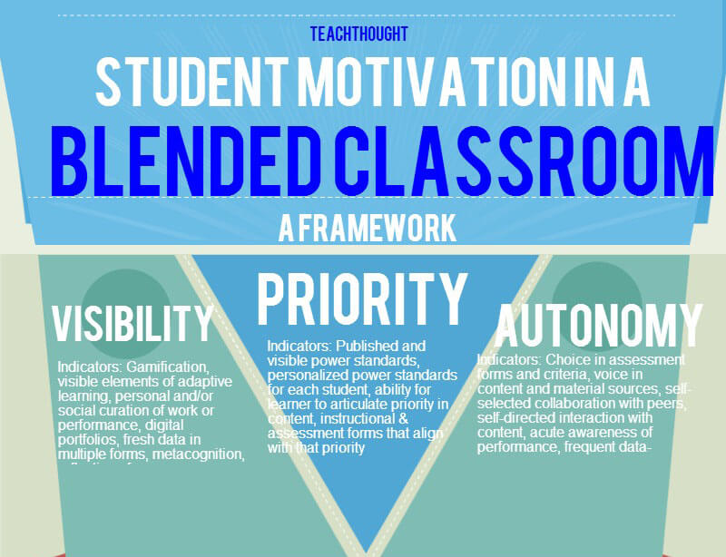
Chaz. (2012). [digital image]. Retrieved from http://chaz11.blogspot.com/2012/03/students-perspective-of-what-turnaround.html
Teachthought. (n.d.). [digital image]. Retrieved from http://teachthought.com/technology/the-benefits-of-blended-learning

Slide 17
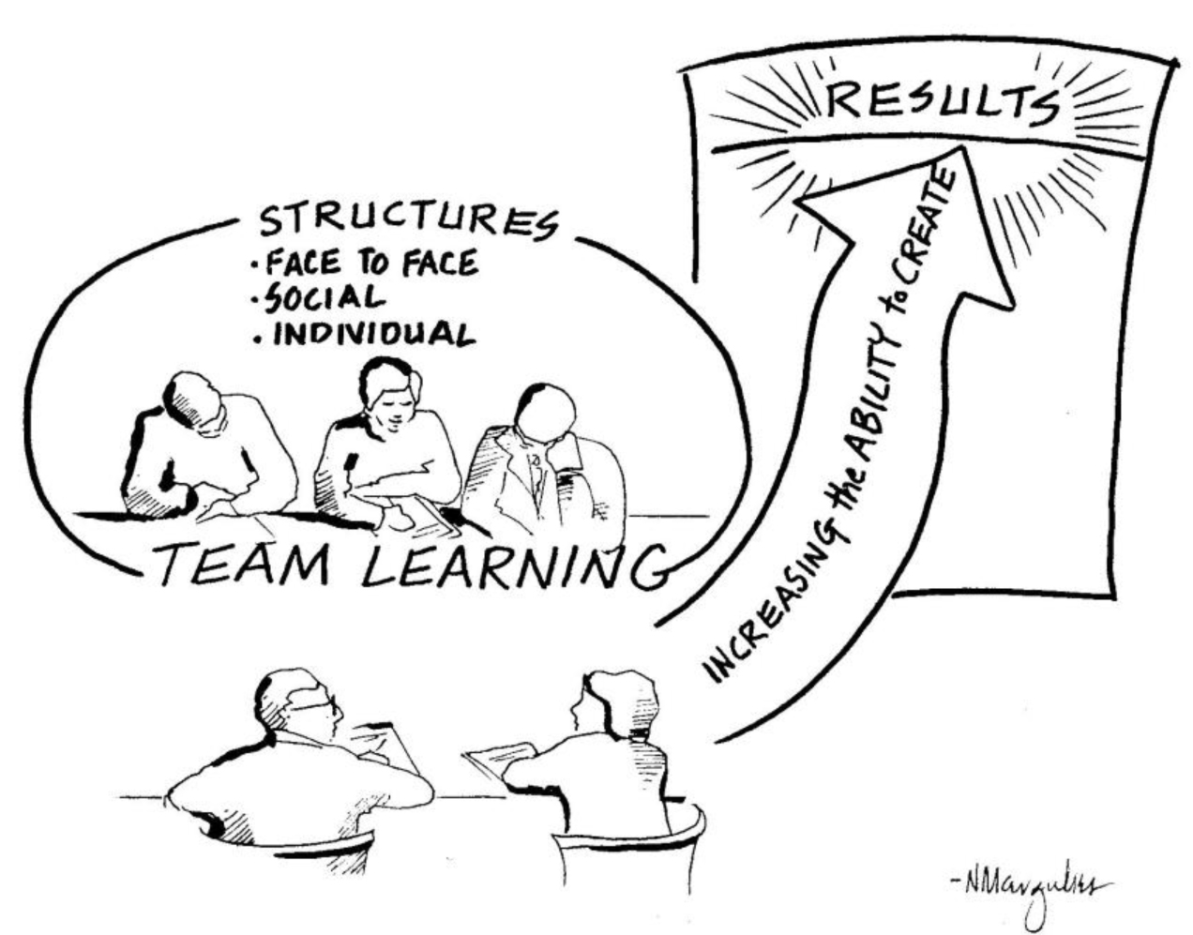
Margulies, N. (n.d.). [digital image]. Retrieved from https://thesystemsthinker.com/creating-business-results-through-team-learning/

Slide 18
College & Career Academy Support Network. (n.d.). [digital image]. Retrieved from https://casn.berkeley.edu/resources.php?r=790

Slide 19
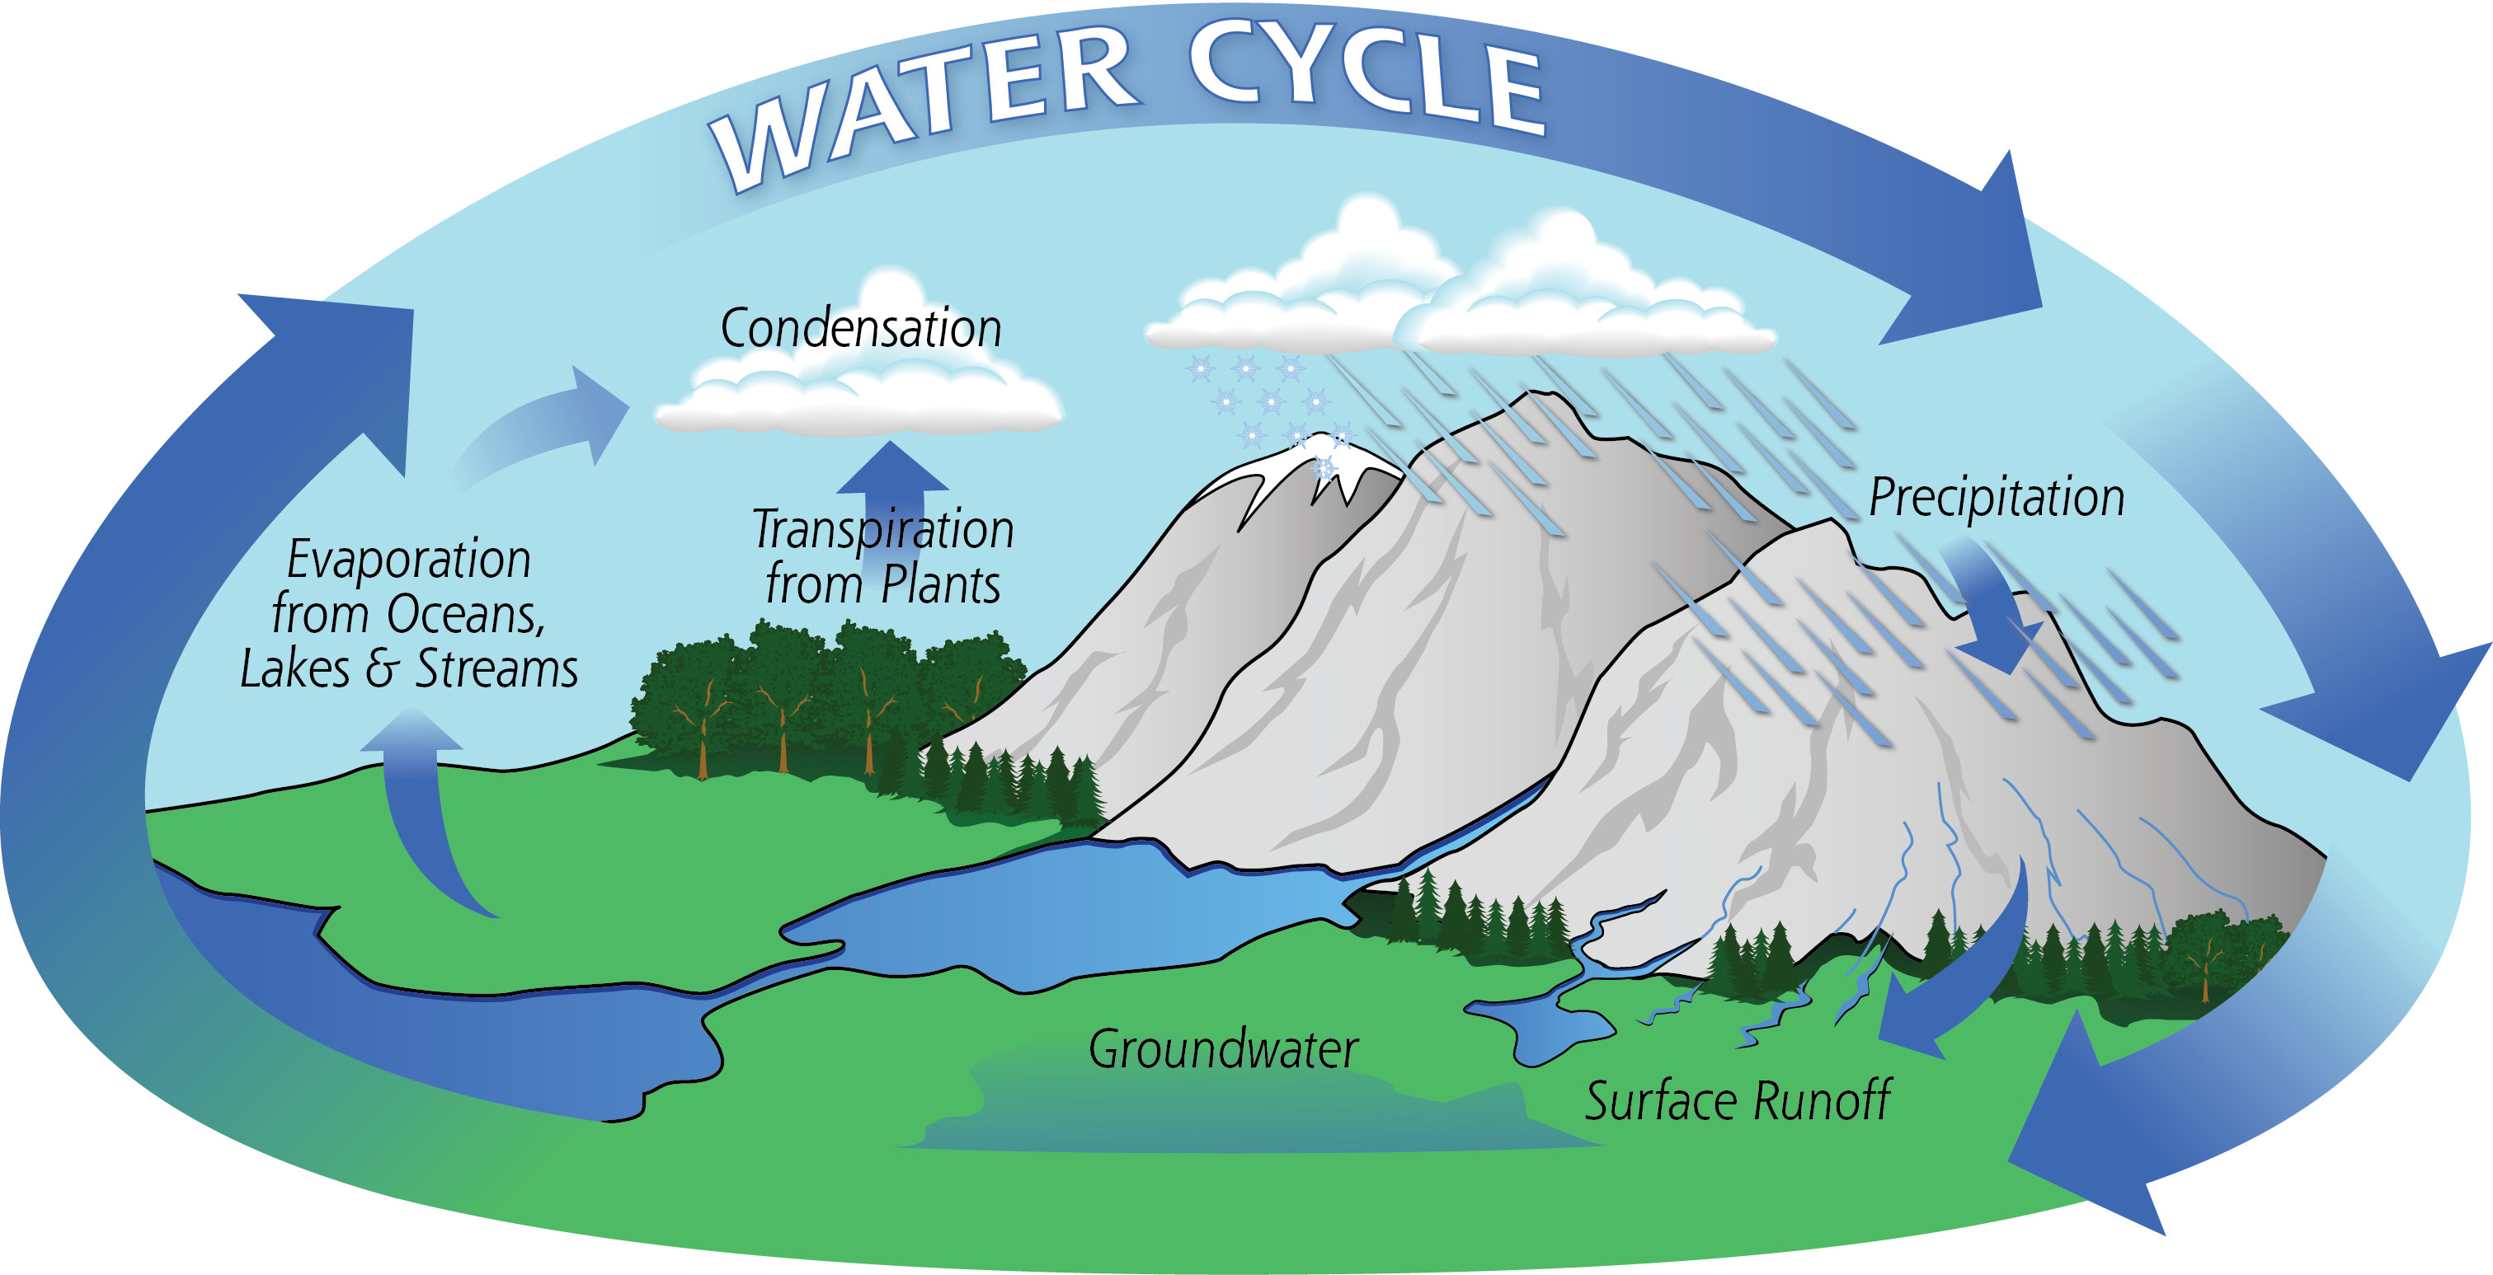
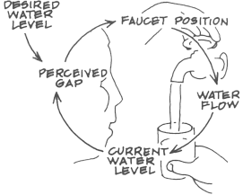
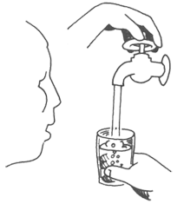
VS.
NASA. (n.d.) [digital image]. Retrieved from https://pmm.nasa.gov/education/water-cycle
Thwink. (2014). [digital image]. Retrieved from http://www.thwink.org/sustain/glossary/SystemsThinking.htm

Slide 20
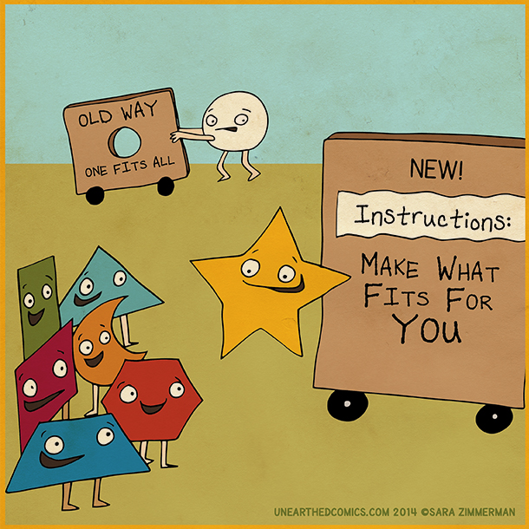
Zimmerman, S. (2014). [digital image]. Retrieved from http://www.edtechupdate.com/personalized-learning/?open-article-id=4595740&article-title=practical-applications-to-individualize-and-personalize-learning&blog-domain=blogspot.com&blog-title=a-principal-s-reflections

Slide 21
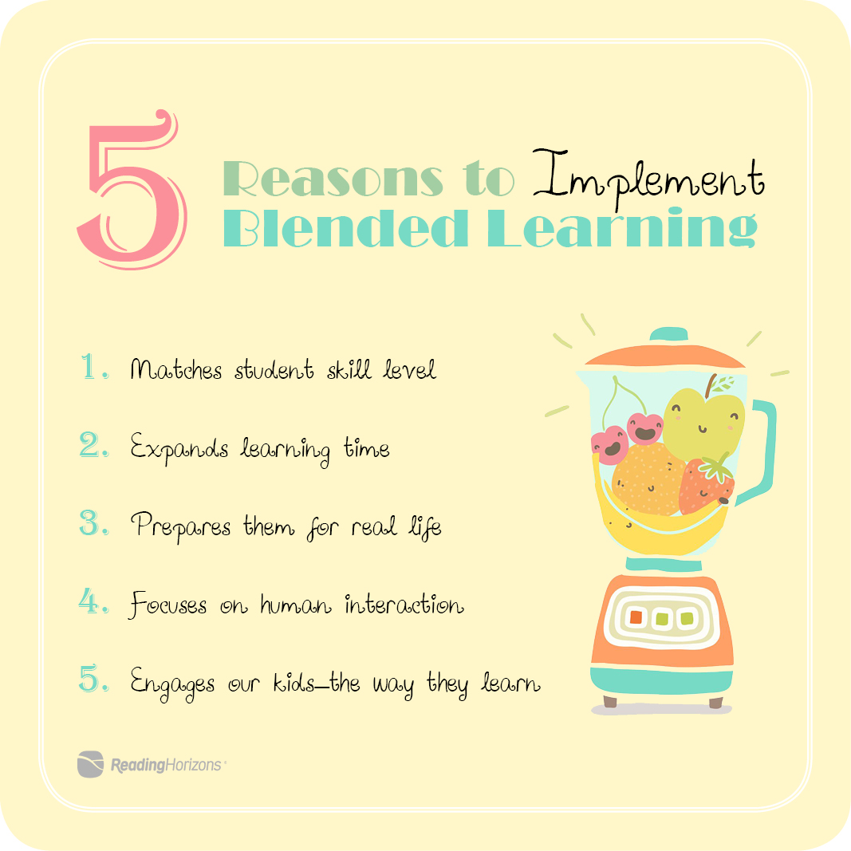
ReadingHorizons. (n.d.). 5 Reasons to Implement Blended Learning. [digital image].
Retrieved from http://www.readinghorizons.com/blog/top-5-reasons-blended-learning-is-important-in-your-classroom

Slide 22
References
Horn, M. B., & Staker, H. (2015). Blended: Using
disruptive innovation to improve schools. San Francisco, CA: Jossey-Bass.
Senge, P. M. (2006). The Fifth Discipline: The Art &
Practice of the Learning Organization. New York, NY: Crown Business.

Slide 23
The Fifth Discipline Applied to Blended
Stephanie Peborde Burke
New Jersey City University
New Classrooms. (n.d.). A blended learning classroom at David Boody Jr. High School in New York City. [photograph].
Retrieved from https://ww2.kqed.org/mindshift/2015/01/12/some-benefits-and-drawbacks-of-blended-learning/

